Slide 1
Data Visualization & Communication
Week 3 Practise Exercises

Slide 2
Exercise 1
Let’s begin by removing entries we know are not real data. Recall from last week that Dognition’s convention for indicating when an account was a “testing” account was to enter a weight that was completely infeasible for the entered breed. In particular, their testing accounts often contained Shih Tzus that were 190 pounds (Shih Tzus typically weigh between 9 and 16 pounds).
In order to remove these data points from our analyses, create a row calculation that can be used on the Filter shelf to remove all entries of Shih Tzus that weigh 190 pounds. This calculated field should use an IF/THEN/ELSE statement, with the AND operator to output one value for each row of data that indicates whether the row belongs in the “keep” category or the “exclude” category. For the rest of the exercises using the dognition_data_no_aggregation data set, use this calculated field on the Filter shelf to exclude Dognition’s testing accounts from your analyses.
Now that we can exclude these data easily, let’s take advantage of the new level of detail the dognition_data_no_ aggregation data set provides over the aggregated data set we used last week by finding out after which games users tend to drop out. To achieve this, we need to use Rank by DogID.
It’s worth taking some time to understand exactly what this variable provides. Recall that Dognition customers are given the tests in the same order each time (with a few exceptions that Eliot told us about in the “Meet Your Dognition Data” video. To facilitate our initial analyses, I ordered each test a dog took by its time stamp in Created At, and included the
rank the test received in this sorted order in its own variable called Rank by DogID. A rank order of 1 in this field indicates

Slide 3
Exercise 1
the test described in that row of data was the first test that dog took, a rank order of 5 in this field indicates that the test described in that row of data was the fifth test the dog took, and so on. I computed a similar rank for all the tests associated with a User ID. This rank, stored in Rank by UserID, indicates the order of tests used by each human user. When a User ID is only associated with one Dog ID, the values of Rank by DogID and Rank by UserID in a row of data will be the same. When a User ID is associated with multiple Dog IDs, the values of Rank by DogID and Rank by UserID in a row of data may differ. You will have to aggregate these variables appropriately to extract the information you want.
The Total Tests Completed variable we used when analyzing the dognition_data_aggregated_by_dogid data set last week was the maximum Rank by DogID value associated with each Dog ID in the dognition_data_no_aggregation data set. This
week, when we need it, we will have to retrieve the maximum rank value associated with a Dog ID ourselves through the level of aggregation we ask when using Rank by DogID.
To determine when users are dropping out of the Dognition test progression, make a bar graph with Rank by DogID as a dimension on the columns shelf and Number of Records on the Rows shelf. Remember, the Dognition tests are organized into subcategories of cognitive abilities and personality attributes the tests are meant to assess (there are 5 subcategories in the first 20 tests comprising the Dognition Assessment). I highly recommend that you place Subcategory Name or Test Name on Color. After which tests do users tend to drop off? Do they drop off in the middle of the tests within a subcategory, or at the end of all the tests associated with a subcategory? What could this mean for Dognition?

Slide 4
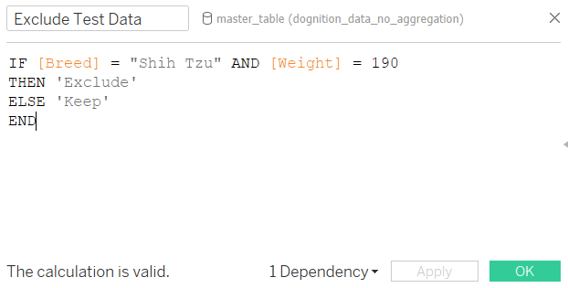
1. Created a calculated field named “Exclude Test Data” with IF-ELSE logic
NOTE :
Check the spelling of “Shih Tzu”
The conditions written for IF fall under ‘Exclude’ category while for ELSE it is ‘Keep’ category.
These 2 points are common mistake because of which when you drag “Exclude Test data” calculation in Filter card, you see either only ‘Keep’ or only ‘Exclude’ category.

Slide 5
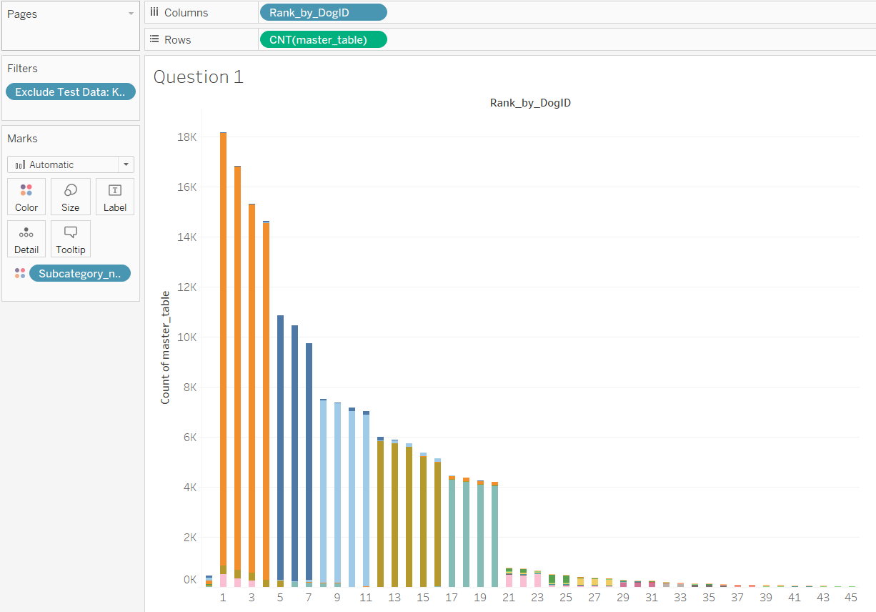
2. Determine when users are dropping out of the dognition test progression? (As guided in exercise 1)

Slide 6
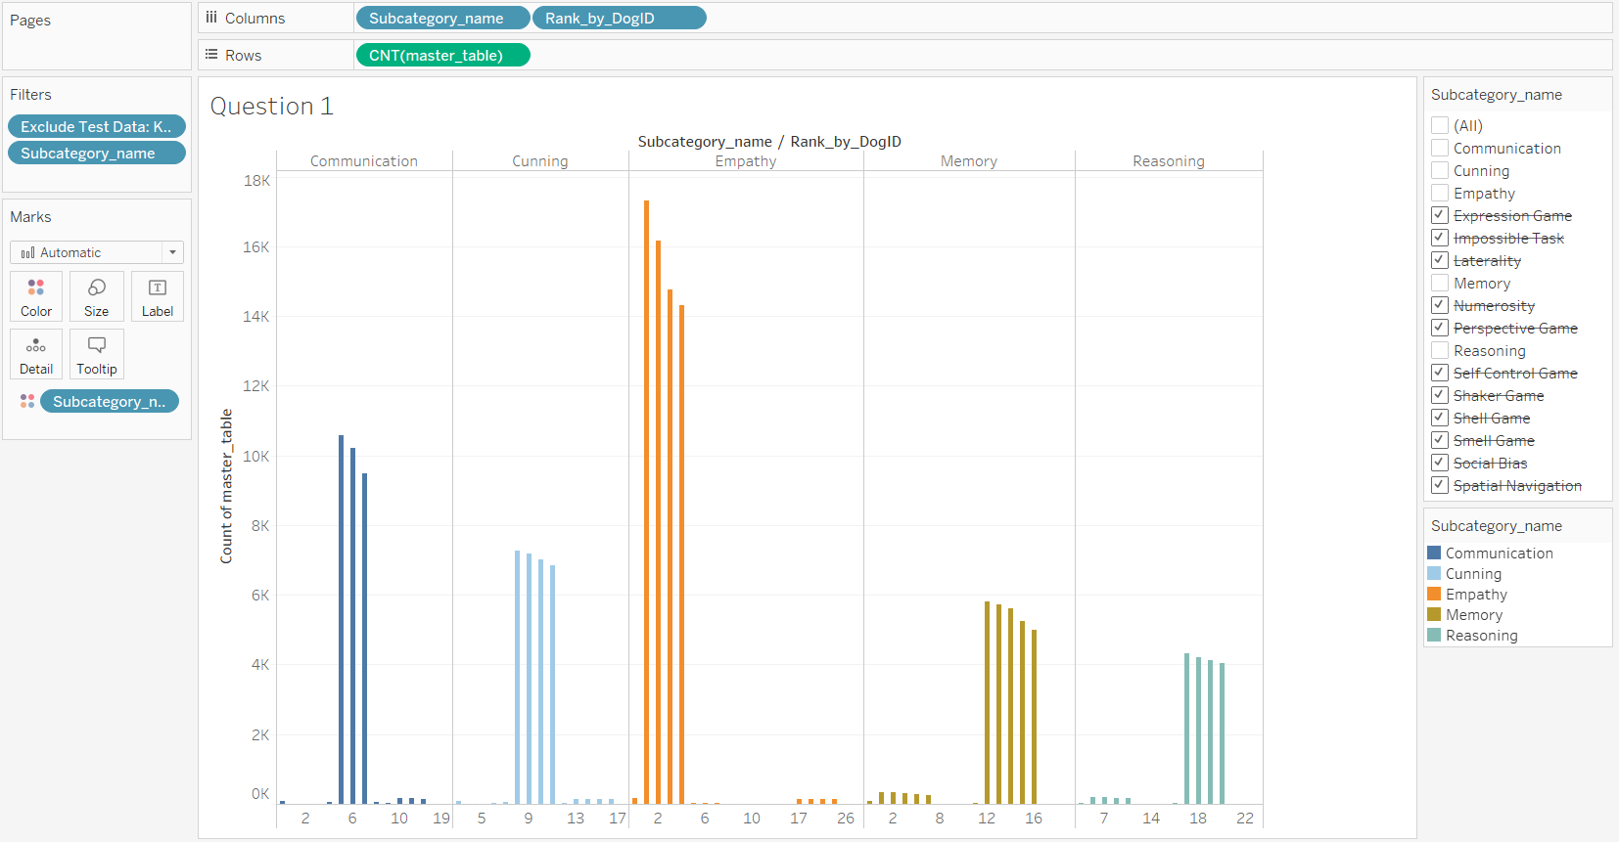
3. How many and which dognition tests in specific sub-category have been completed?
(5 sub-categories were selected for clear graph visualization)

Slide 7
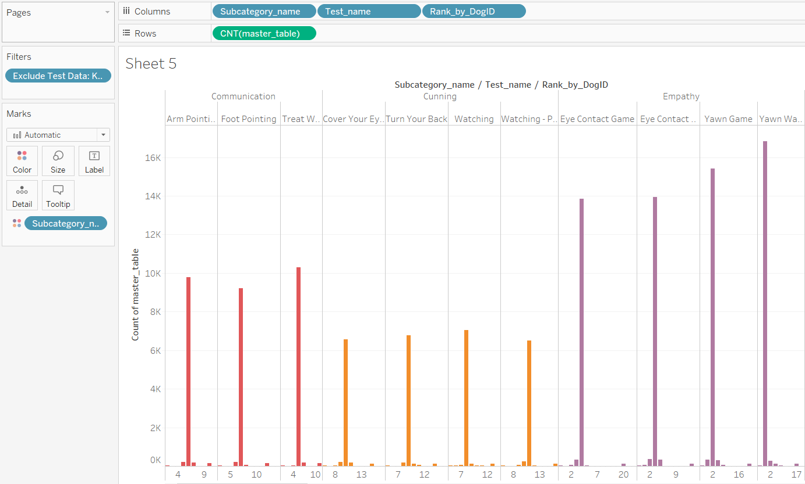
4. Do they drop off in the middle of the tests within a subcategory, or at the end of all the tests associated with a subcategory? (Majority says, in the middle of tests within a subcategory)

Slide 8
Exercise 2
In order to better target advertisements or reminder emails, it would be useful to know when customers tend to play the Dognition games. To assess this, we can take advantage of the information provided in Created At in the dognition_data_ no_aggregation data set. Created At has a time stamp of every test recorded by a customer (this information was lost when we used the version of the data set that aggregated over Dog ID last week). If we place Created At on the Columns shelf and Number of Records on the Rows shelf, we an use the full extent of Tableau’s date hierarchy to see when tests are taken most often. During which days of the week are customers most likely to play the games (hint: use the “weekday” level on the date hierarchy)? During which hours of the day are customers most likely to play the games (hint: use the “hour” level on the date hierarchy)?
Look carefully at your visualizations that display which hours of the day customers are most likely to play games. Does anything look suspicious to you? It should! The data currently make it look like a lot of games are played in the middle of the night, but that doesn’t make sense. If you look at the raw data behind your graphs, you’ll start to get a feeling of what might be going on with this field of data.
It should become apparent that the time stamps are provided in “Coordinated Universal Time” (UTC) and do not take time zones or daylight savings into account. Unfortunately, it is not very easy to adjust UTC time stamps for changes in time zones in Tableau. The best way to accomplish such a correction would be to find or assemble a separate data set that would provide a UTC correction for every entry in one of our location-related variables, and then blend that secondary data set with dognition_data_no_aggregation (a process we learned about in Lesson 3 this week).

Slide 9
Exercise 2
These data sets are not easy to find, but for the purposes of this course, we have assembled a data set that provides UTC corrections for a collection of United States zip codes. We will use a new method, called joining, to combine this data with the dognition_data_no_aggregation data set. The results of a joining will be easier to work with than the results of data blending in these specific circumstances. To join the zip code correction data with the dognition_data_no_aggregation data set, download a separate file called dognition_data_no_aggregation_with_time_zone_correction from the course website. This excel file will have the original dognition_data_no_aggregation data in one worksheet called “master table,” and the zip code correction data in a separate worksheet called “time zone correction.” Connect to this file with Tableau.
Follow steps in this link to perform LEFT JOIN : https://help.tableau.com/v2020.2/pro/desktop/en-us/joining_tables.htm
Then go to a Tableau worksheet. You will see that Diff from UTC, which is the variable we essentially imported through the left join we just implemented, is in its own “time_zone_correction” heading in the variables pane. You can now use this variable as any other variable. We now have what we need to correct Created At for differences in time zone.
Make a new row calculation that will adjust each value of Created At by the correction provided in Diff from UTC. Dates have their own unique functions for adding and subtracting values; I suggest you use the DATEADD function. Type the following formula into your calculated field: DATEADD('hour',[Diff from UTC],[Created at])

Slide 10
Exercise 2
Make sure you specify “hour” in this formula so that the calculation knows to adjust the date at the level of hour rather than minute, second, or year, etc. Put your new calculated variable on the columns shelf, and number of records on the rows shelf. Keeping your new variable as a dimension, adjust it so that it is displaying data at the level of “hour” in the date hierarchy. Right-click (control-click) on the “Null” subheading in the graph and choose “Hide.”
Next, make sure your calculation is outputting what you expect it to by right-clicking (control-clicking) on one of the data points to look at the underlying data. You should be able to see the original version of Created At, the new corrected version of Created At (which will have whatever title you gave it when making the calculated field), and Diff from UTC for each row. Does it appear that the calculation was implemented correctly? If not, double-check your calculated field.
When you are confident your calculation is correct, you are ready to interpret your new, time-zone corrected results. To aid in this, bring another copy of your (Corrected) Created At variable to the filter shelf. Choose the options that allow you to filter by Weekdays.” Show the quick filter. What hours of the day do customers tend to play games (although, remember, these results only reflect US countries where you have zip code data)? Do those hours change at different times of the week? What implications could this have for when you should send reminders or advertisements to customers or potential customers?

Slide 11
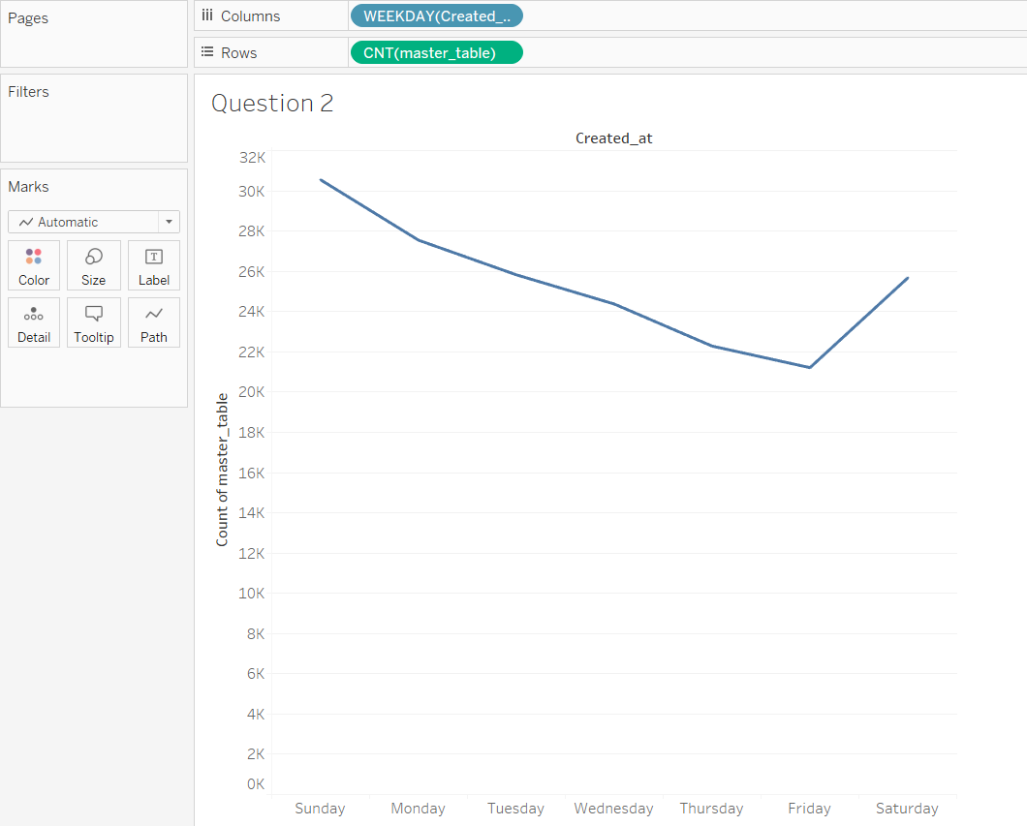
1. During which days of the week are customers most likely to play the games?
(Most played: Sunday and Least played: Friday)

Slide 12
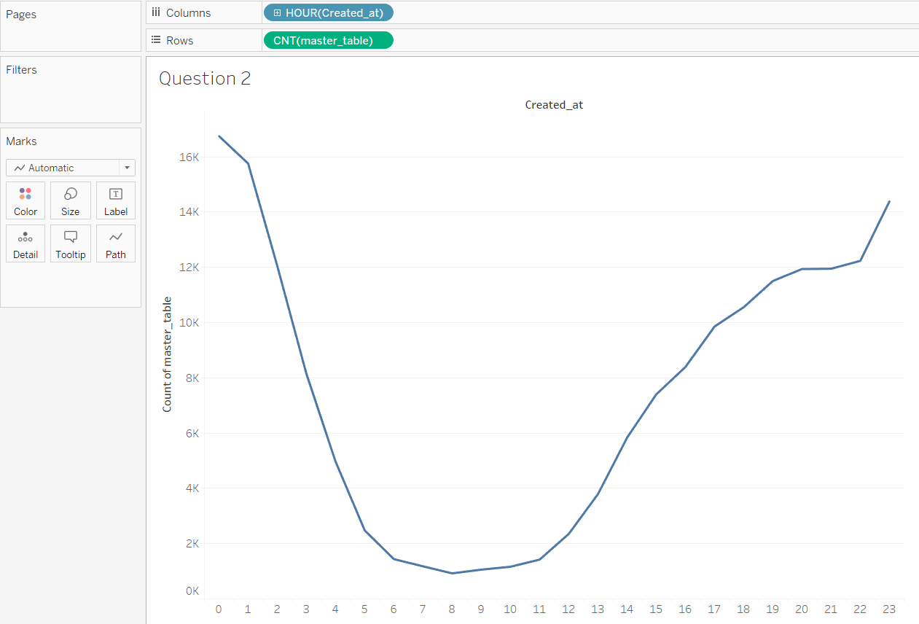
2. During which hours of the day are customers most likely to play the games?
(Most played: 12 am and Least played: 8 am | But this statistics is completely wrong)

Slide 13
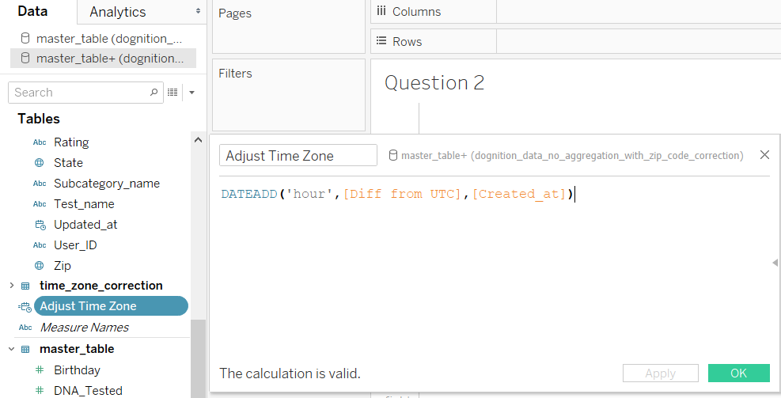
3.1 Row calculation that will adjust each value of Created At by the correction provided in Diff from UTC.
NOTE : Perform this exercise on new JOINed data source

Slide 14
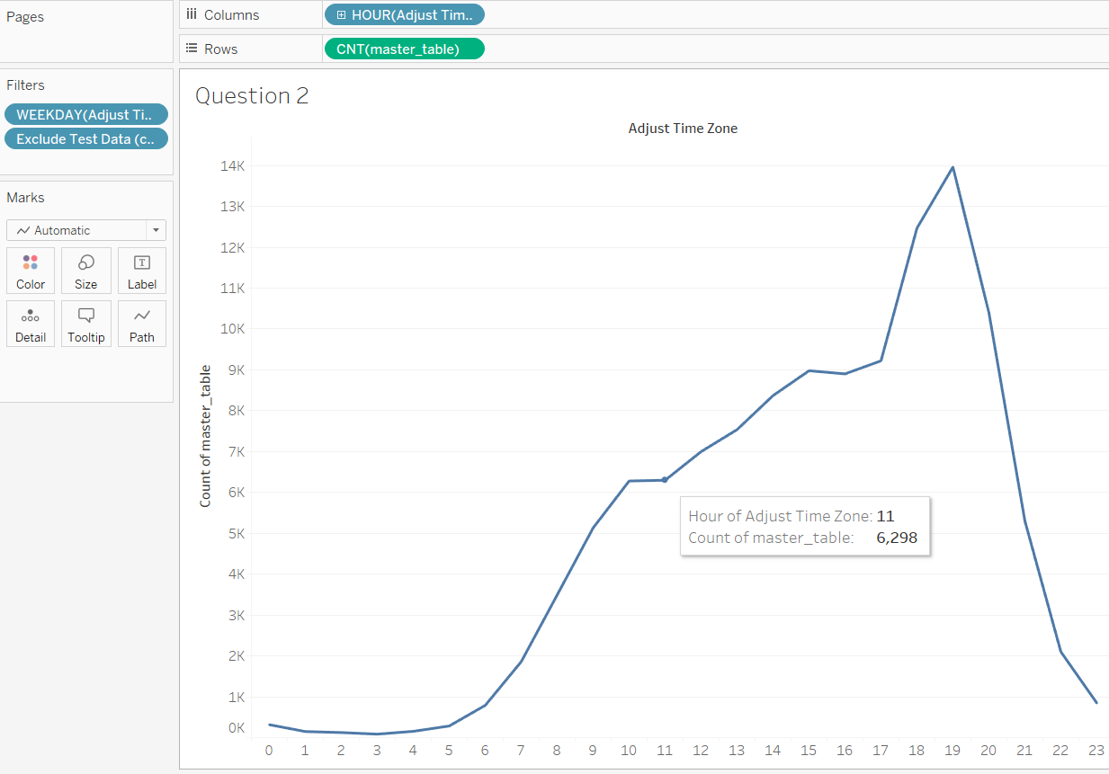
3.2 After using corrected time-zone in filter, check what hours of the day do customers tend to play games?
(Most played: 7pm and Least played: 3pm)

Slide 15
Exercise 3
During discussions off-camera, Eliot shared some information about other experiments Dognition has implemented as well. In particular, Dognition periodically tries offering a “Free Start” promotion to customers that gives the customers the first four tests for free. The hypothesis (or hope) would be that once potential customers get a chance to experience the product first-hand, they will be more likely to buy a subscription. In this exercise, we are going to assess whether the “Free Start” promotions worked.
Free Start User indicates whether the user began their Dognition experience with a free start. Currently Free Start User has three possible values: 1, 0, and NULL. The Dognition team confirmed that the 0 and Null entries should be considered the same group, and neither group had free starts. To implement the suggested grouping, right-click (control-click) on Free Start User to make a grouped variable that has just two options: “Free Start” or “No Free Start.” Next, use either a visualization or text tables through the Marks Card to get an idea of how many data points you have for both categories. Also examine when Free Start users were enrolled, and how many non-Free Start users were enrolled at the same time. This will give you an idea of the kind of control groups to which you might have access when drawing conclusions.
Next, put the Free Start User(Group) on the Columns shelf, followed by Rank by DogID as a dimension. Put Dog ID on the rows shelf, aggregated by Count (distinct). You should see two graphs that depict the number of dogs who have completed 1- 45 tests, one for those who began with a free start, and one for those who didn’t. These visualizations make it look like perhaps Free Start users do not finish as many tests as non-Free Start users, but it’s hard to know for sure because there are so many fewer Free Start users to start with. A more direct way to assess the success of Free Start users would be to

Slide 16
Exercise 3
compute a table calculation that would tell you what percentage of users who start the Dognition Assessment make it to each test along the way. Fortunately, this is one of the default table calculations Tableau offers.
Without removing any of the pills you currently have on the Columns or Rows shelves, drag another instance of Dog ID to the Rows shelf. Click on the drop down and choose quick table calculation option, followed by “percent of total.” You should now have one set of bar charts that show you the raw numbers of dogs who completed a certain number of tests, and a second set of charts that show you what percentage of a total those raw numbers represent.
The goal in making the table calculation was to determine what percentage of those who start their Dognition experience with a free start finish each number of tests. Do the charts you see depict that? Probably not, because the calculated field is likely making calculations with all the data in the work space together at the same time, rather than doing the calculation separately for different partitions within the work space. You have to tell Tableau what partitions the table calculation should take into account. To do this, click on the table calculation to edit it. Can you figure out how to set the advanced options so that the table calculation computes percentages separately for Free Start users vs non-Free Start users? Based on these results, do you think the Free Start tests seem to be working as intended?

Slide 17
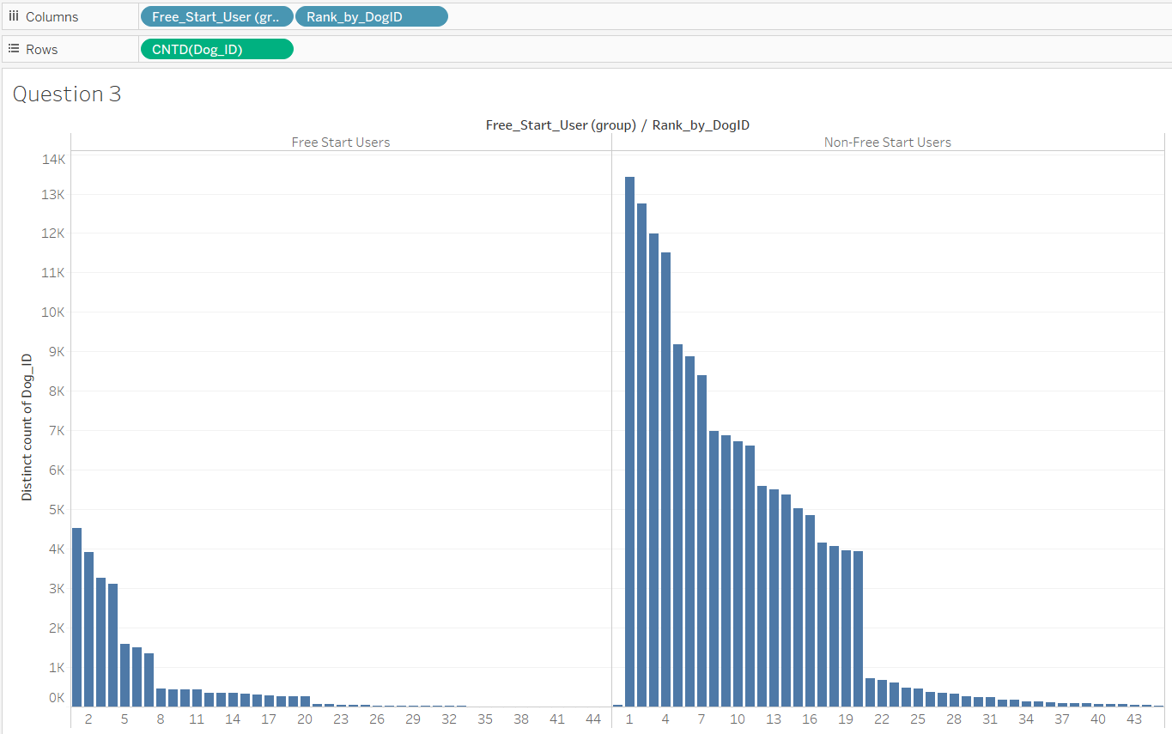
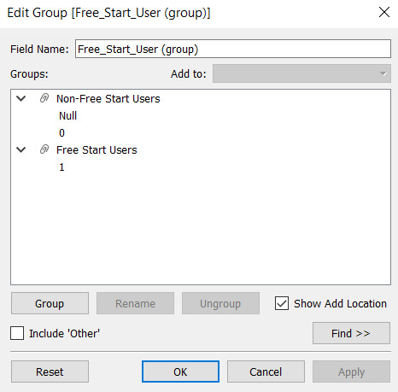
1.1 Determine whether the “Free Start” promotions, if implemented, work?

Slide 18
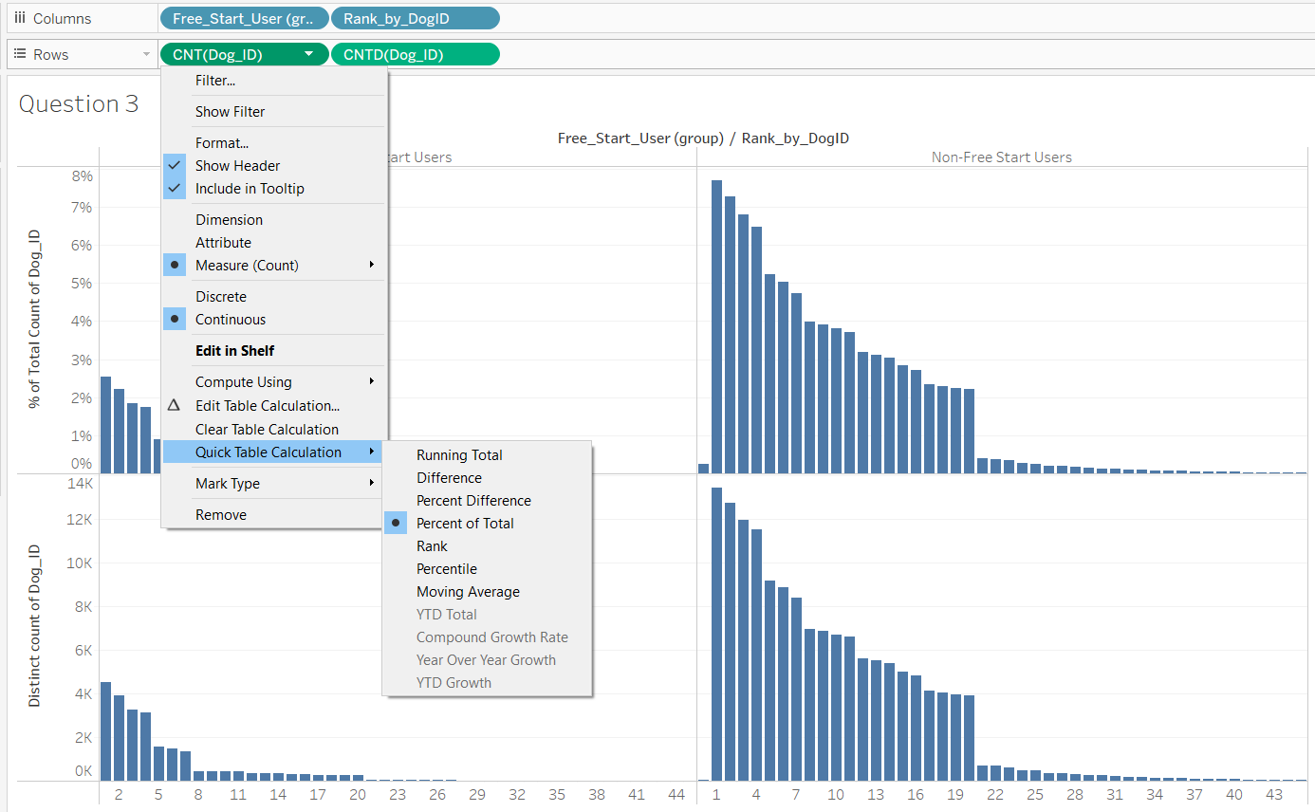
1.2 Compute a table calculation that would tell what % of users who start the dognition assessment make it to each test along the way. (Use Quick Table Calculation)

Slide 19
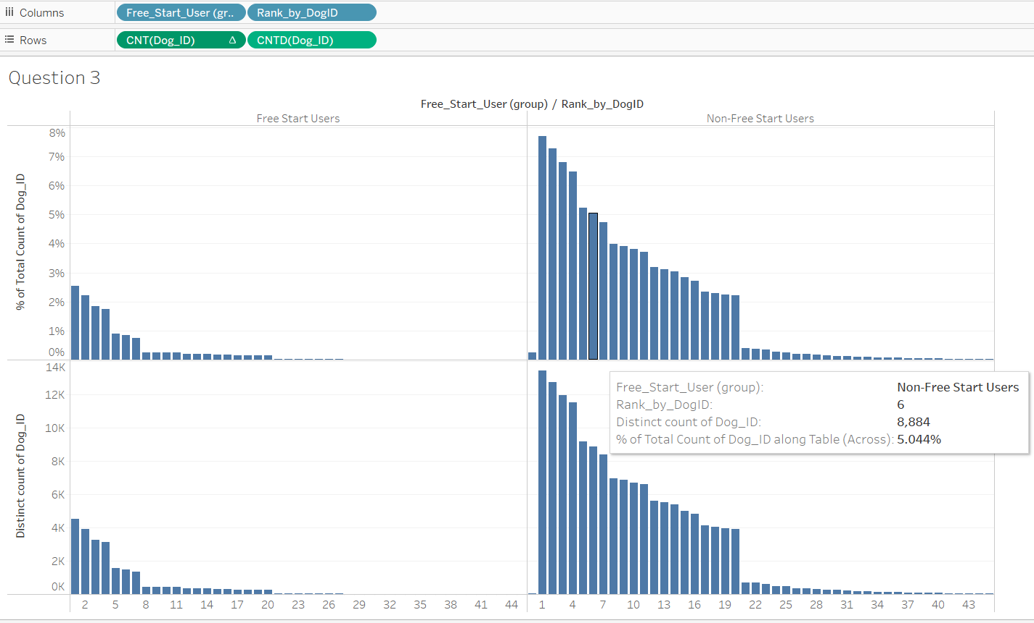
1.2 Compute a table calculation that would tell what % of users who start the dognition assessment make it to each test along the way. (Output)

Slide 20
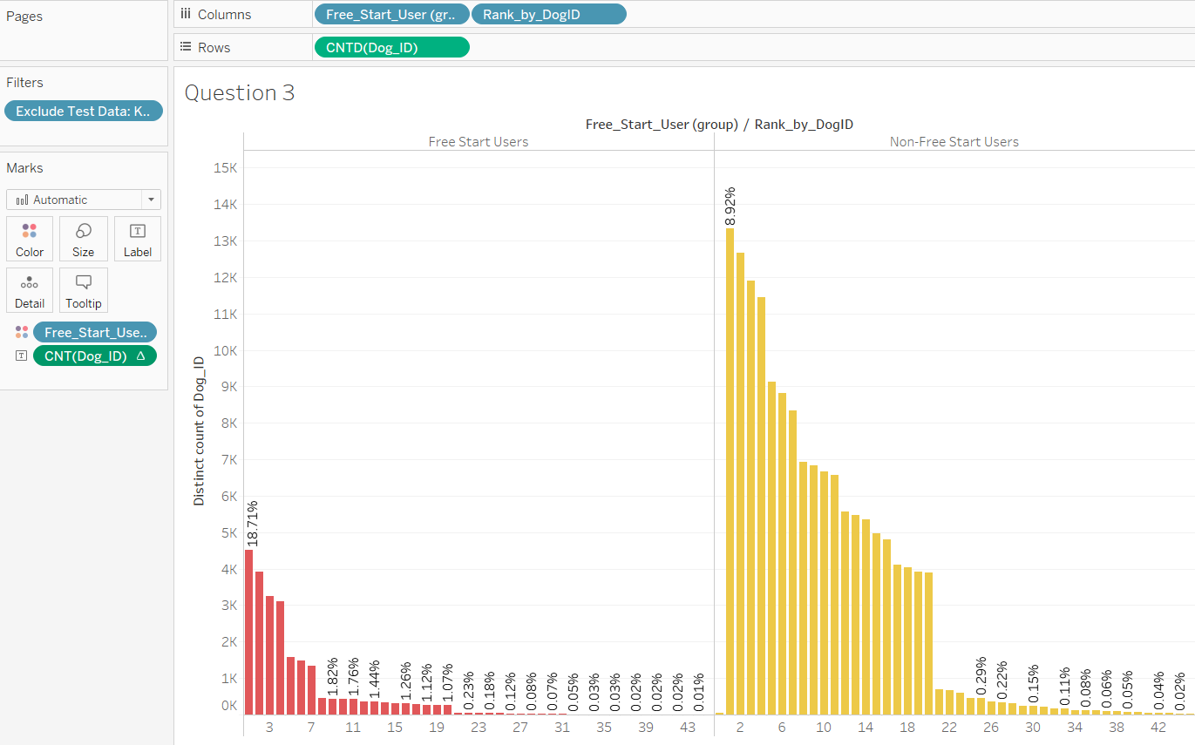
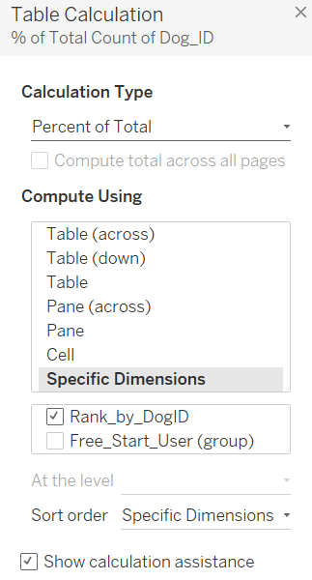
1.3 How to set the advanced options so that the table calculation computes percentages separately for Free Start users vs non-Free Start users?

Slide 21
Exercise 4
In this exercise, we are going to use table calculations to determine how we could use Tableau to dynamically recreate the ranks stored in the Rank by DogID and Rank by UserID variables. These variables, remember, chronologically rank each test according to its associated time stamp in Created At, and restart the ranking either for every dog or for every customer.
To begin, make a group of Dog IDs that only has a few Dog IDs included (randomly choose 4 or 5 DogIDs). Use your new grouped variable and the filter shelf to ensure that you only analyze the data from the few dogs you chose in your workspace. This will make troubleshooting your calculations much faster.
Next, place Dog ID on the rows shelf, followed by Test Name on the right-hand side. Then put Created At on Text, and adjust the variable aggregation so that you get a level of detail that is appropriate for the purpose of the exercise. You should see a table with Dog ID in the left-most column, Test Name in the column to the right of that, and the time the
test was created in the right-most column.
Our goal is going to be to create a column between the Test Name and Created At columns that uses a calculation (NOT Rank by DogID – that would be cheating!) to indicate the ranked order each test was completed, sorted from 1 to the last test taken. To achieve this, make a calculation that starts with RANK, and then drag the Created At pill from your workspace into the parentheses Tableau automatically inserts in your calculated field. Notice that Tableau will likely insert a date function with the level of detail you specified on the Created At pill in your table. You will need to choose whether the rank should be ascending or descending.

Slide 22
Exercise 4
As you troubleshoot your calculation, think carefully about whether the variables in your calculation need to be aggregated, and if so, how. Also think about what level of detail of the time stamps provided in Created At would be most useful. Once you have a valid calculation, drag it to Details. Then right-click (control-click) to edit the calculation, and navigate to the “Compute Using” screen. Chose the options you think are most appropriate for your goals. Once selected, convert the pill to a dimension and place it in the appropriate place on the Rows shelf. Assess whether your calculation
succeeded by comparing your rank to the rank provided in Rank by DogID.
Can you make a similar calculation that ranks the tests completed by each human user, mimicking the information provided in Rank by UserID? Can you figure out how to include both ranks in the same table?

Slide 23
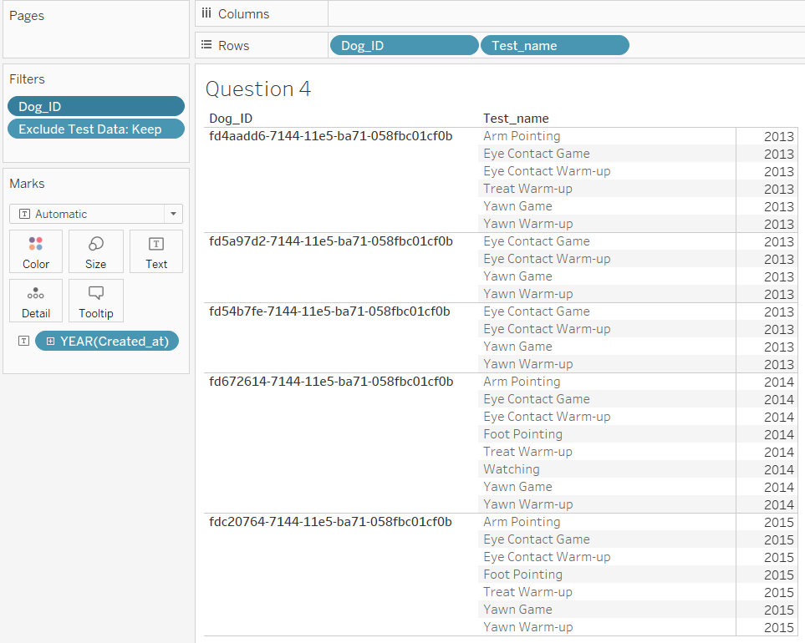
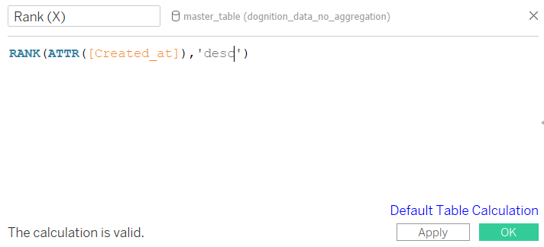
1.1 Our goal is to dynamically create the ranks for Dog Id. To achieve this, make a calculation that starts with RANK. (Randomly filter out 5-6 dogs to easily output the interpretation)
This can be ‘asc’ or ‘desc’. I have used ‘asc’ for further illustrations

Slide 24
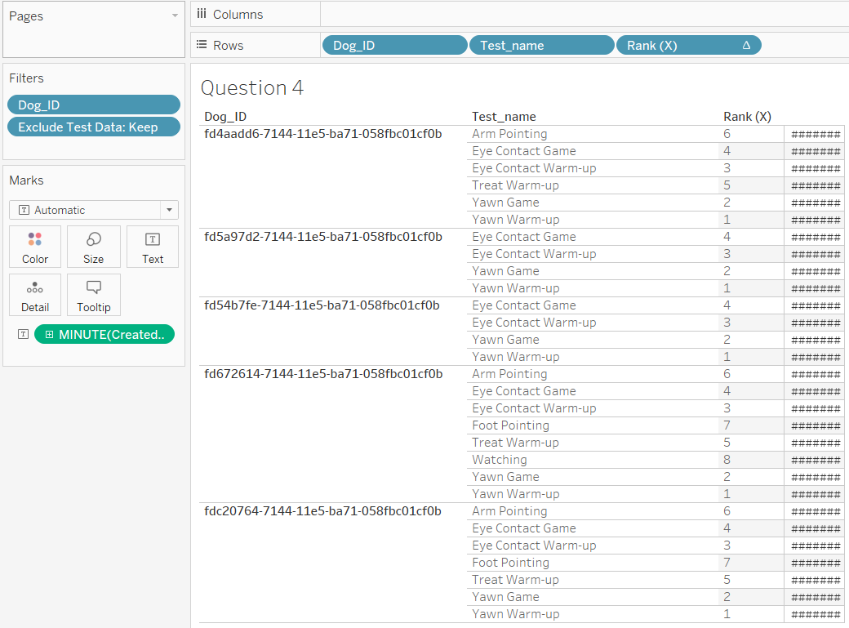
1.2 Use the calculation, RANK. Don’t forget to make it DIMENSION (Discrete) in ROW shelf

Slide 25
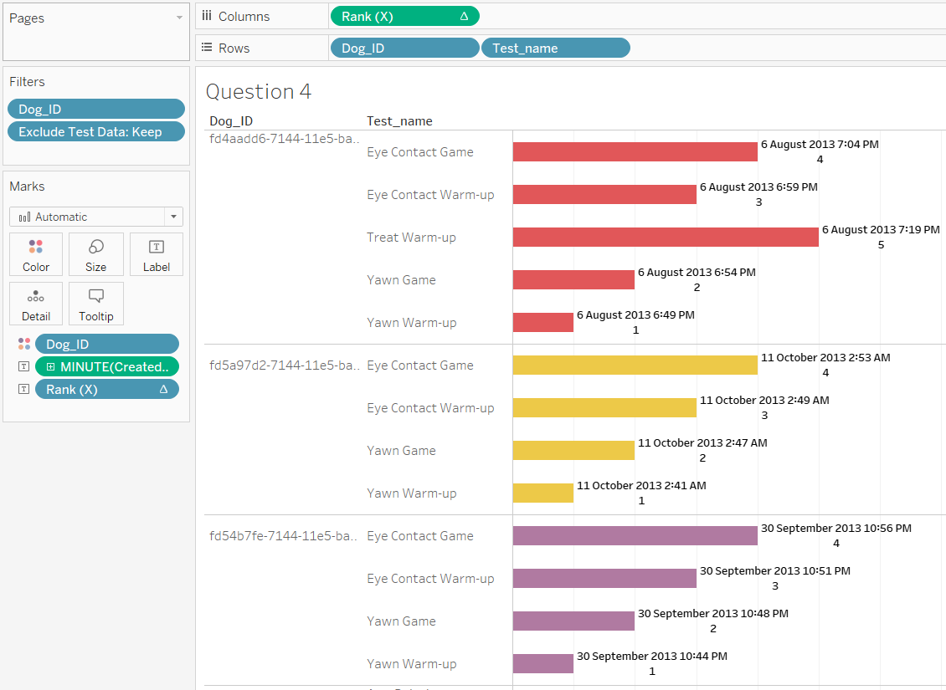
1.3.1 Assess whether your calculation succeeded.
(Method 1 : Bar graph with ‘Created_at’ & ‘Rank (X)’ labels for easy assesment )

Slide 26
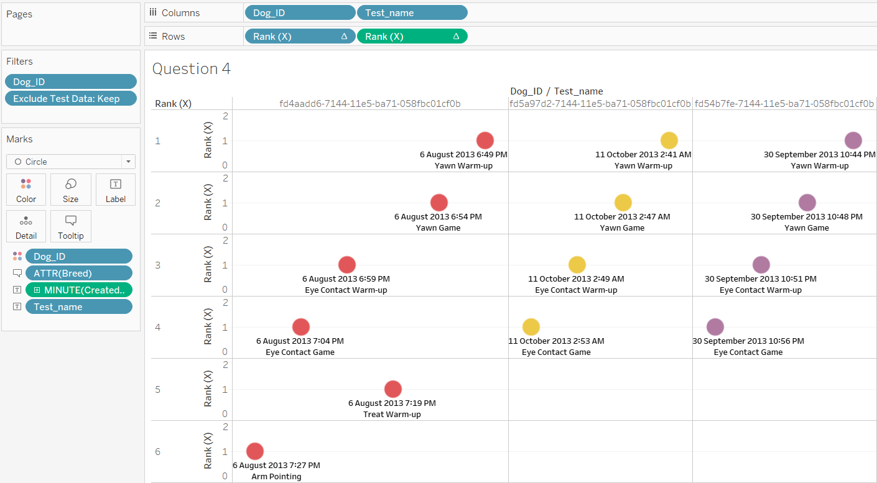
1.3.2 Assess whether your calculation succeeded.
(Method 2 : Change the shape to ‘Circle’ and flip the axes )

